Slide 1
CHAPTER 14
Bond Prices and Yields

Slide 2
Bond Characteristics
Bonds are debt. Issuers are borrowers and holders are creditors.
  The indenture is the contract between the issuer and the bondholder.
  The indenture gives the coupon rate, maturity date, and par value.

Slide 3
Bond Characteristics
Face or par value is typically $1000; this is the principal repaid at maturity.
The coupon rate determines the interest payment.
  Interest is usually paid semiannually.
  The coupon rate can be zero.
  Interest payments are called “coupon payments”.

Slide 4
U.S. Treasury Bonds
Bonds and notes may be purchased directly from the Treasury.
Denomination can be as small as $100, but $1,000 is more common.
Bid price of 100:08 means 100 8/32 or $1002.50
Note maturity is 1-10 years
Bond maturity is 10-30 years

Slide 5
Corporate Bonds
Callable bonds can be repurchased before the maturity date.
Convertible bonds can be exchanged for shares of the firm’s common stock.
Puttable bonds give the bondholder the option to retire or extend the bond.
Floating rate bonds have an adjustable coupon rate

Slide 6
Preferred Stock
Dividends are paid in perpetuity.
Nonpayment of dividends does not mean bankruptcy.
Preferred dividends are paid before common.
No tax break.
Equity
Fixed income

Slide 7
Innovation in the Bond Market
Inverse Floaters
Asset-Backed Bonds
Catastrophe Bonds
Indexed Bonds
  Treasury Inflation Protected Securities (TIPS).

Slide 8
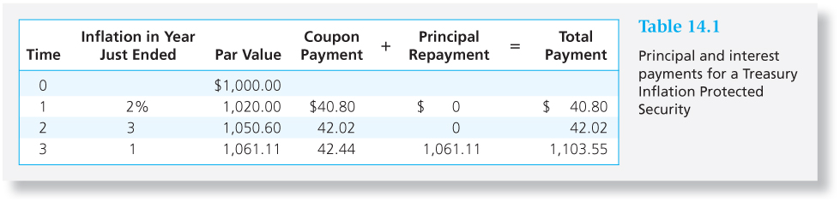
Table 14.1 Principal and Interest Payments for a Treasury Inflation Protected Security

Slide 9
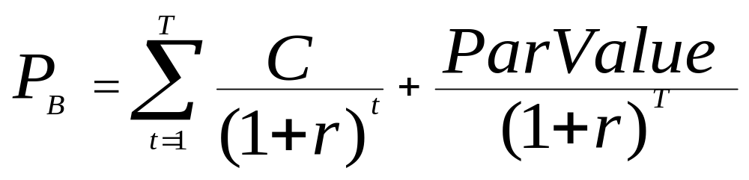
Bond Pricing
P_{B} = Price of the bond
C_{t} = interest or coupon payments
T = number of periods to maturity
r = semi-annual discount rate or the semi-annual yield to maturity

Slide 10
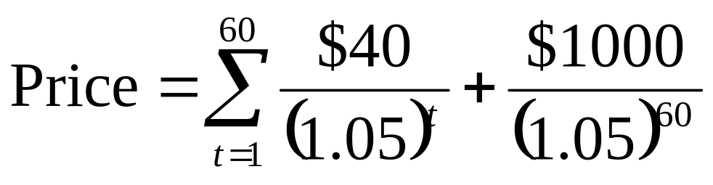
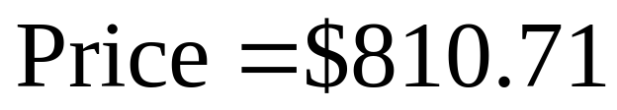
Example 14.2: Bond Pricing
Price of a 30 year, 8% coupon bond.
Market rate of interest is 10%.

Slide 11
Bond Prices and Yields
Prices and yields (required rates of return) have an inverse relationship
The bond price curve (Figure 14.3) is convex.
The longer the maturity, the more sensitive the bond’s price to changes in market interest rates.

Slide 12
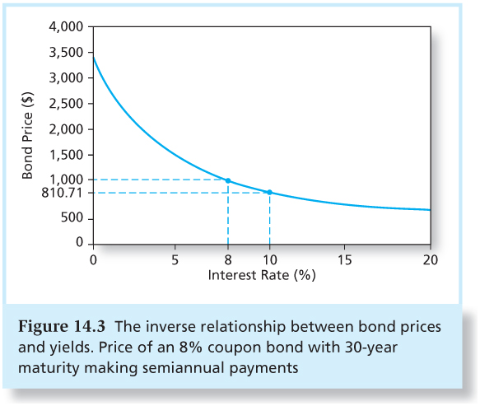
Figure 14.3 The Inverse Relationship Between Bond Prices and Yields

Slide 13
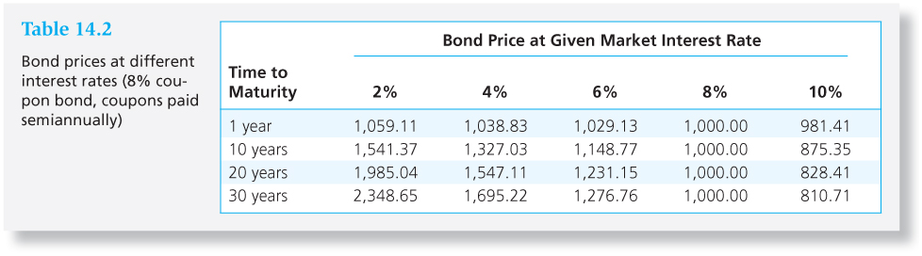
Table 14.2 Bond Prices at
Different Interest Rates

Slide 14
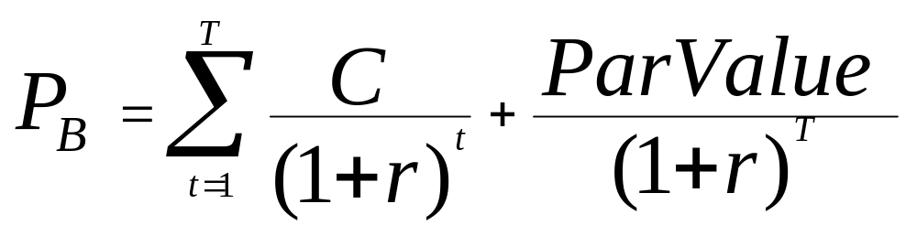
Yield to Maturity
Interest rate that makes the present value of the bond’s payments equal to its price is the YTM.
Solve the bond formula for r

Slide 15
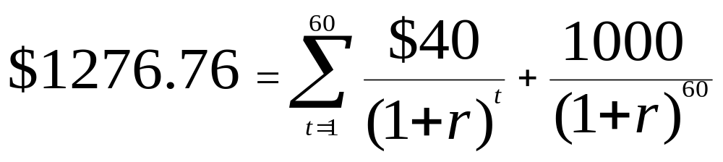
Yield to Maturity Example
Suppose an 8% coupon, 30 year bond is selling for $1276.76. What is its average rate of return?
r = 3% per half year
Bond equivalent yield = 6%
EAR = ((1.03)²)-1=6.09%

Slide 16
YTM vs. Current Yield
YTM
Current Yield
The YTM is the bond’s internal rate of return.
YTM is the interest rate that makes the present value of a bond’s payments equal to its price.
YTM assumes that all bond coupons can be reinvested at the YTM rate.
The current yield is the bond’s annual coupon payment divided by the bond price.
For bonds selling at a premium, coupon rate > current yield>YTM.
For discount bonds, relationships are reversed.

Slide 17
Yield to Call
If interest rates fall, price of straight bond can rise considerably.
The price of the callable bond is flat over a range of low interest rates because the risk of repurchase or call is high.
When interest rates are high, the risk of call is negligible and the values of the straight and the callable bond converge.

Slide 18
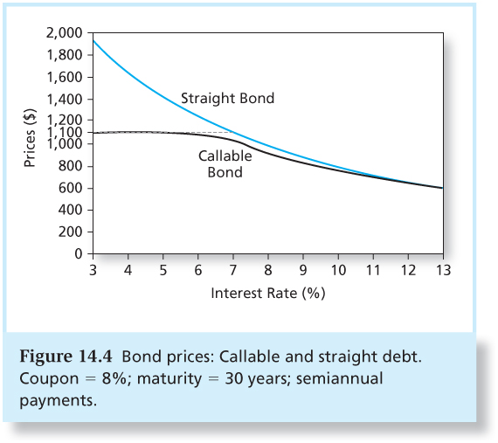
Figure 14.4 Bond Prices: Callable and Straight Debt

Slide 19
Realized Yield versus YTM
Reinvestment Assumptions
Holding Period Return
  Changes in rates affect returns
  Reinvestment of coupon payments
  Change in price of the bond

Slide 20
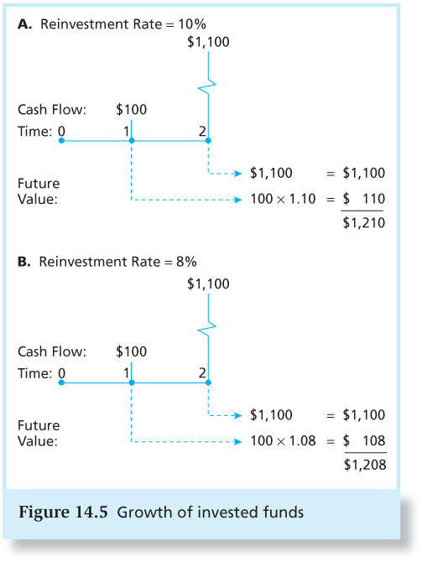
Figure 14.5 Growth of Invested Funds

Slide 21
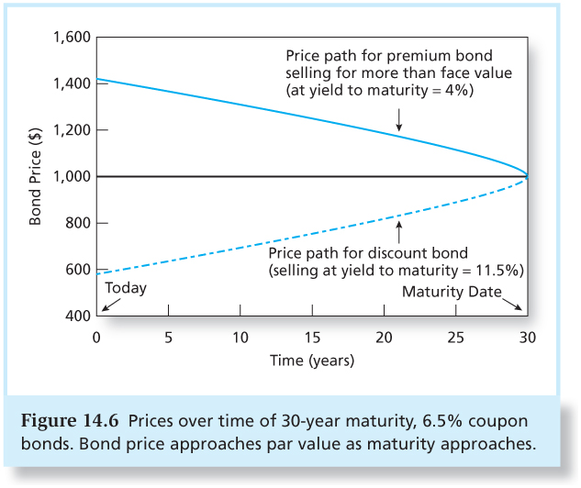
Figure 14.6 Prices over Time of 30-Year Maturity, 6.5% Coupon Bonds

Slide 22
YTM vs. HPR
YTM
HPR
YTM is the average return if the bond is held to maturity.
YTM depends on coupon rate, maturity, and par value.
All of these are readily observable.
HPR is the rate of return over a particular investment period.
HPR depends on the bond’s price at the end of the holding period, an unknown future value.
HPR can only be forecasted.

Slide 23
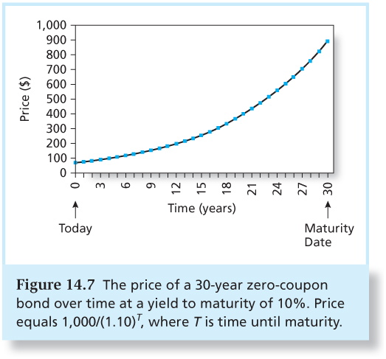
Figure 14.7 The Price of a 30-Year Zero-Coupon Bond over Time

Slide 24
Default Risk and Bond Pricing
Rating companies:
  Moody’s Investor Service, Standard & Poor’s, Fitch
Rating Categories
  Highest rating is AAA or Aaa
  Investment grade bonds are rated BBB or Baa and above
  Speculative grade/junk bonds have ratings below BBB or Baa.

Slide 25
Factors Used by Rating Companies
Coverage ratios
Leverage ratios
Liquidity ratios
Profitability ratios
Cash flow to debt

Slide 26
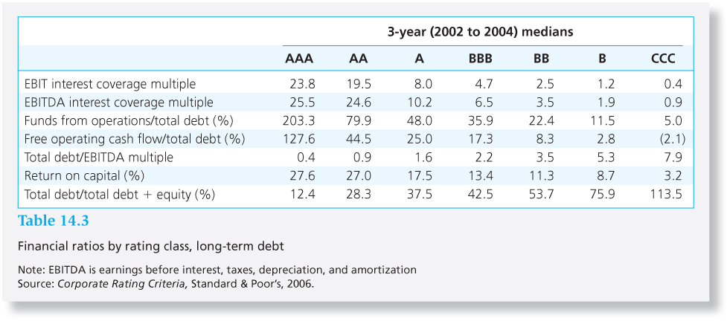
Table 14.3 Financial Ratios and Default Risk by Rating Class, Long-Term Debt

Slide 27
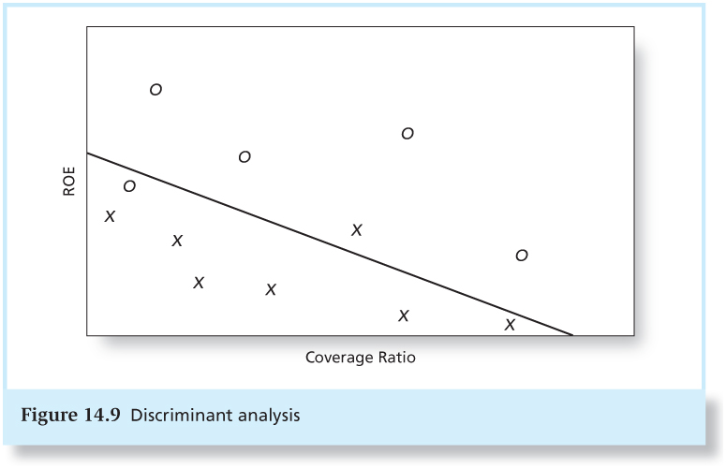
Figure 14.9 Discriminant Analysis

Slide 28
Protection Against Default
Sinking funds – a way to call bonds early
Subordination of future debt– restrict additional borrowing
Dividend restrictions– force firm to retain assets rather than paying them out to shareholders
Collateral – a particular asset bondholders receive if the firm defaults

Slide 29
Default Risk and Yield
The risk structure of interest rates refers to the pattern of default premiums.
There is a difference between the yield based on expected cash flows and yield based on promised cash flows.
The difference between the expected YTM and the promised YTM is the default risk premium.

Slide 30
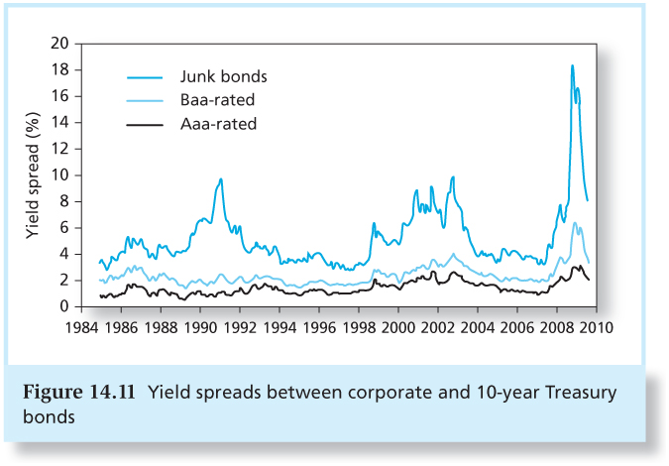
Figure 14.11 Yield Spreads

Slide 31
Credit Default Swaps
A credit default swap (CDS) acts like an insurance policy on the default risk of a corporate bond or loan.
CDS buyer pays annual premiums.
CDS issuer agrees to buy the bond in a default or pay the difference between par and market values to the CDS buyer.

Slide 32
Credit Default Swaps
Institutional bondholders, e.g. banks, used CDS to enhance creditworthiness of their loan portfolios, to manufacture AAA debt.
CDS can also be used to speculate that bond prices will fall.
This means there can be more CDS outstanding than there are bonds to insure!

Slide 33
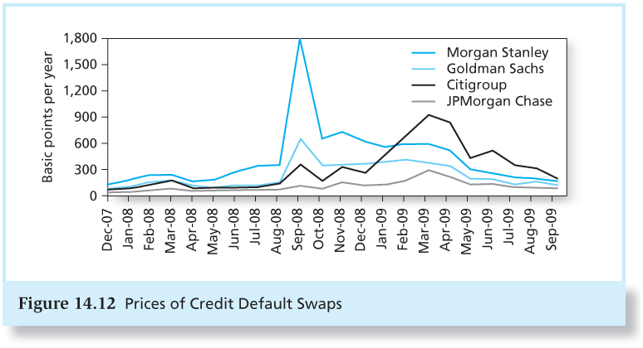
Figure 14.12 Prices of Credit Default Swaps

Slide 34
Credit Risk and Collateralized Debt Obligations (CDOs)
Major mechanism to reallocate credit risk in the fixed-income markets
  Structured Investment Vehicle (SIV) often used to create the CDO
  Loans are pooled together and split into tranches with different levels of default risk.
  Mortgage-backed CDOs were an investment disaster in 2007

Slide 35
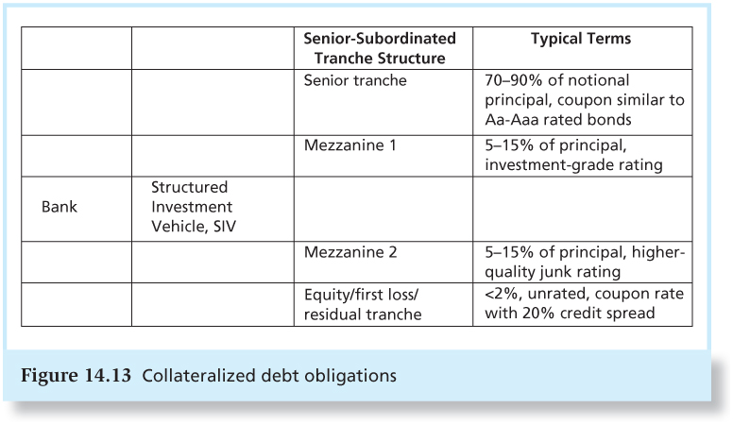
Figure 14.13 Collateralized Debt Obligations

